Slide 1




Slide 2

DATA ARRANGEMENT - (Circular Relationship)

Slide 3

Test time on : Articles
QR CODE:

Slide 4
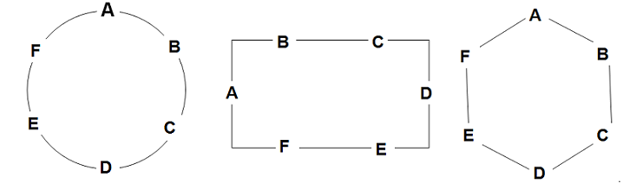
INTRODUCTION
CIRCULAR ARRANGEMENT
A Circular arrangement can be defined as an arrangement having a closed loop. Typical examples include situations wherein seating arrangements around a table have to be made. The table can be of any shape and need not necessarily be circular. This is illustrated by the following diagrams.

Slide 5
CONCEPTS
Though the above diagrams look very different in terms of their structure, there would be minimal deviations in the interpretation of some common clues for all these diagrams.
For example,
A is sitting opposite to D.
B is sitting to the immediate left of A.
B is sitting between A and C.

Slide 6
CONCEPTS
Movements around the circular arrangement:
For the people facing the centre:
Left movement is called clockwise rotation.
Right movement is called anti-clockwise rotation.
For people facing outside, the opposite is true:
Left movement is called anti-clockwise rotation.
Right movement is called clockwise rotation.

Slide 7
DIRECTION:Q01-Q04
P, Q, R, S, T, U, V and W are sitting round the circle and are facing the centre:
P is second to the right of T who is the neighbour of R and V.
S is not the neighbour of P.
V is the neighbour of U.
Q is not between S and W. W is not between U and S.

Slide 8
QUESTION-Q01
Which two of the following are not neighbours ?
RV
UV
RP
QW
Answer: A

Slide 9
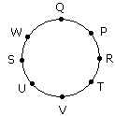
Explanation: Q01
From the above diagram R and V are not neighbours

Slide 10
QUESTION-Q02
Which one is immediate right to the V ?
P
U
R
T
Answer: D

Slide 11
Explanation: Q02
T is immediate right to the V.

Slide 12
QUESTION-Q03
Which of the following is correct ?
P is to the immediate right of Q
R is between U and V
Q is to the immediate left of W
U is between W and S
Answer: C

Slide 13
Explanation: Q03
Option C is the correct answer

Slide 14
DIRECTION-Q04-Q07
Read the following information given below and answer the questions that follow.
P, Q, R, S, T, U and V are seven friends and are sitting in a circle facing the center of the circle.
V is second to the left of S and is the neighbour of T and U.
S is not a neighbour of R or T.
P is neighbour of Q and R.

Slide 15
QUESTION-Q04
Which of the following is correct?
Q is between P and S.
S is between U and P.
T is to the immediate right of V.
U is to the immediate left of V.
Answer: A

Slide 16
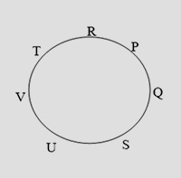
Explanation: Q04
The persons are sitting in the following way:
Hence Q is between P and S.

Slide 17
QUESTION-Q05
Which of the following has the pair with the second person sitting to the immediate right of the first person?
QU
VU
TR
PT
Answer: B

Slide 18
Explanation: Q05
The persons are sitting in the following way:
U is sitting to immediate right of V.

Slide 19
QUESTION-Q06
Which of the following will be S’s position after T and S interchange their places?
Neighbour of V and R
To the immediate left of R
To the immediate right of U
Neighbour of R and P
Answer: A

Slide 20
Explanation: Q06
The persons are sitting in the following way:
If S and T will interchange their positions then S will be the neighbour of V and R.

Slide 21
QUESTION-Q07
Which of the following has the second person sitting between the first and third persons?
SPQ
VRT
QRP
VUS
Answer: D

Slide 22
Explanation: Q07
The persons are sitting in the following way:
U is sitting between V and S.

Slide 23
DIRECTION-Q08-Q10
Study the information given below and answer the given questions.
Eight friends A, B, C, D, E, F, G and H are sitting in a circle, but not necessarily in the same order. Four of them are facing outside and four of them are facing the centre.JTS Institute Bank PO Exams -Work Book 27 JTS Institute .
1. E faces outside, Both the immediate neighbours of E face the centre. H sits second to the right of E. B sits third to the left of E.
2. D faces the centre. Both the immediate neighbours of D face outside.
3. G sits second to the left of A. B sits third to the right of H
4. F is an immediate neighbour of D. C is an immediate neighbour of G.
5. D is not an immediate neighbour of B.

Slide 24
QUESTION-Q08
Who amongst the following sits exactly between F and C (and is also their neighbour)?
E
B
A
G
Answer: B

Slide 25
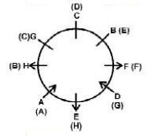
Explanation: Q08

Slide 26
QUESTION-Q09
If all the people are made to sit in an alphabetical order, in clockwise direction, starting from A, the position of whom amongst the following remains the same (excluding A )?
E
G
C
F
Answer: D

Slide 27
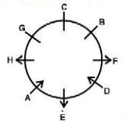
Explanation: Q09

Slide 28
QUESTION-Q10
Four of the following five are alike in a certain way, based on the information given above and so form a group. Which is the one that does not belong to that group?
HA
FH
GC
DA
Answer: C

Slide 29
Explanation: Q10

Slide 30
DIRECTION-Q11-Q15
Study the following information carefully and answer the given questions.
A, B,C, D, E, F, G and H are sitting around a circle facing the centre but not necessarily in the same order.
B sits second to the left of H’s husband. No female is an immediate neighbour of B.
D’s daughter sits second to the right of F. F is the sister of G. F is not an immediate neighbour of H’s husband.
Only one person sits between A and F. A is father of G.
H’s brother D sits on the immediate left of H’s mother.
Only one person sits between H’s mother and E.
Only one person sits between H and G. G is the mother of C. G is not an immediate neighbour of E

Slide 31
QUESTION-Q11
Which of the following is true with respect to the given seating arrangement?
C is cousin of E.
B and H’s husband are immediate neighbours of each other.
No female is an immediate neighbour of C.
H sits third to the left of her daughter.
B is mother of H.
Answer: E

Slide 32
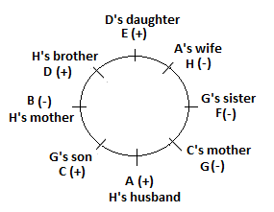
Explanation: Q11

Slide 33
QUESTION-Q12
Four of the following five are alike in a certain way based on the given information and so form a group. Which is the one that does not belong to that group?
F
C
E
H
Answer: B

Slide 34
Explanation: Q12

Slide 35
QUESTION-Q13
What is the position of A with respect to his grandchild?
Immediate right
Third to the right
Third to the left
Second to the left
Answer: C

Slide 36
Explanation: Q13
C is grandchild of A. Thus A's position with respect to his grandchild is immediate right.

Slide 37
QUESTION-Q14
Who amongst the following is D’s daughter?
B
C
E
G
Answer: C

Slide 38
Explanation: Q14

Slide 39
QUESTION-Q15
What is the position of A with respect to his mother-in-law?
Immediate left
Third to the right
Third to the left
Second to the right
Answer: D

Slide 40
Explanation: Q15
B is mother-in-law of A. Hence, A's position with respect to his mother-in-law is second to the right.

Slide 41




THANK YOU
+91 78150 95095
codemithra@ethnus.com
www.codemithra.com

